Slide 1
Greenhouse effect
Deforestation
Global Warming
Ways that humans are
destroying the earth:
Acid Rain
Extinction of animals
Pollution

Slide 2
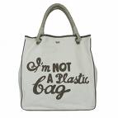
What are the different ways that people are protecting the earth?
Renewable sources
of energy
Recycling
Ways that humans are
protecting the earth:
Car sharing/public transport
‘Bags for life’ in shops

Slide 3
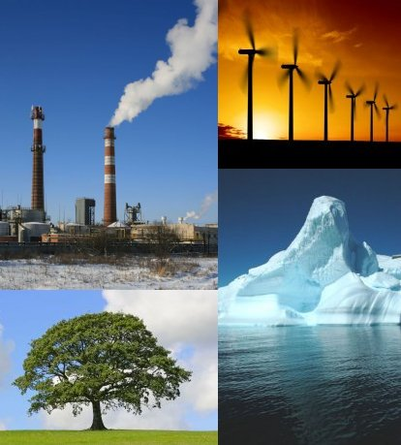
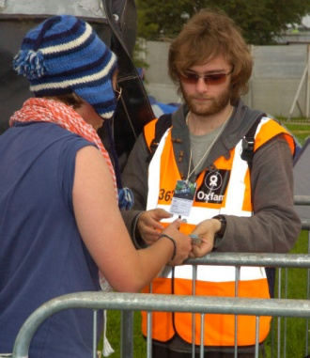
Religious people believe we should be stewards towards the world. What do you think this means?
Hint :- Think about the job of a steward at a football event or a concert/ festival. What do they have to do?

Slide 4
Definitions of stewardship
A steward is like a caretaker who looks after and cares for the world.
Stewardship is a God given responsibility to manage or control the Earth.
It means carefully looking after something for the real owner. Christians and Muslims believe the Earth belongs to God.
Notes:
Complete the L4/L5 sheets

Slide 5
Religious people believe that human
beings are stewards and we should care
for the world and it is our responsibility
to do this.
The term in Islam is ‘Khalifah.’

Slide 6
Muslims believe that Allah has handed the planet over to humans to look after. Humans are guardians or Khalifahs.

Slide 7
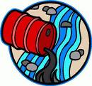
So does “dominion” and “rule” mean we can do what we like?
NO – dominion means “kingship” implying we should rule wisely. It means being responsible for God’s world.
NO- doing what we like has led to the current situation where fossil fuels are running short, some species of animals are extinct and the world is heavily polluted.

Slide 8
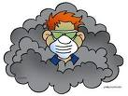
WHAT DO YOU THINK?
Did God make a mistake in giving
humans the responsibility of looking
after the world? Why?

Slide 9
“The world is there for us humans to enjoy; that’s all that matters.”
Do you agree?
Why?

