Slide 2
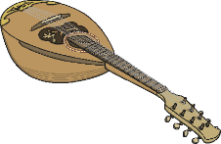
The Modern Musical Period
1932
Composer John
Williams is born.
1952
Queen Elizabeth II
begins her reign.
2013
Prince George is
born.
1914 – 1918
First World War
Modern
1900
1920
1940
1960
1980
2000
Today
Late Romantic/
Early 20th Century
1969
Neil Armstrong is the first person to walk on the Moon.
1989
Berlin Wall is
demolished.
1912
The Titanic sinks.
1979
Margaret Thatcher becomes the first British female prime minister.
1939 – 1945
Second World War

Slide 3
George Gershwin
26th September 1898 – 11th July 1937

Slide 4
George Gershwin
George Gershwin was born in New York. His family were Jews from Russia who fled to the USA to escape increasing anti-Semitism. When George was 10 years old, his parents bought a piano. Although the piano was intended for George’s older brother Ira, it was George who took a greater interest in learning and he soon started having lessons. By the time he was 14, George’s piano teacher wrote to his sister: “I have a new pupil who will make his mark if anybody will. The boy is a genius.”
George left school when he was 15 years old and started a career in music, working for a musical publishing company and writing his own songs. George wrote jazz and ragtime songs. Ragtime is a style of music usually played on the piano with a pattern of a strong – weak – strong –weak beat.

Slide 5
George Gershwin
George began to find success as a song writer. He started to write musicals for Broadway, some of which he wrote with his brother Ira. One of the most successful of these is ‘Porgy and Bess’. George also wrote a score for a film starring two of the most famous film stars of the day, Fred Astaire and Ginger Rogers.
Some of Gershwin’s most famous compositions include ‘I Got Rhythm’, ‘Summertime’, ‘’S Wonderful’ and ‘Someone to Watch Over Me’.
Try It!
Listen to one of Gershwin’s most famous pieces, ‘Rhapsody in Blue.’ Flutter your fingers to copy the quick notes played by the clarinet at the start. Pretend to be a conductor showing the changes in dynamics and tempo during the piece, using any signals you want.

Slide 6
Duke Ellington
29th April 1899 – 24th May 1974

Slide 7
Duke Ellington
Edward Kennedy Ellington, known as ‘Duke’ was born in Washington DC. Duke’s grandparents had been slaves and like most African Americans at the time, Duke was a victim of racial prejudice at times. Both of his parents were pianists and when Duke was seven years old, he started piano lessons. Around this time, he was given the nickname ‘Duke’ because of his good manners.
Duke became a well-known jazz pianist and composer. Jazz is a type of American music that has roots in blues and ragtime. It has lots of improvisation and solos from different instruments.
Duke’s jazz orchestra, The Washingtonians, played at the famous Cotton Club in Harlem. In jazz, orchestras are often known as big bands. At the time, African Americans were allowed to perform at the club but not allowed in as customers. Performers even had to enter via a back door.

Slide 8
Duke Ellington
Duke and his big band wrote some of the world’s most famous jazz pieces, including ‘I’m Beginning to See the Light’, ‘It Don’t Mean a Thing if It Ain’t Got that Swing’, ‘Take the A Train’ and ‘In a Sentimental Mood’.
In an era of racism, Duke was proud of who he was and this is reflected in compositions, such as ‘Black and Tan Fantasy’, ‘Black, Brown and Beige’ and ‘Creole Rhapsody’. He said: “My men and my race are the inspiration of my work. I try to catch the character and mood and feeling of my people.”
Duke was awarded the Presidential Medal of Honour and the Legion d’Honneur, both the highest awards a civilian can receive; the first in the USA, the second in France. He won 14 Grammy awards and has a star on the Hollywood ‘Walk of Fame’.

Slide 9
Leonard Bernstein
25th August 1918 – 14th October 1990

Slide 10
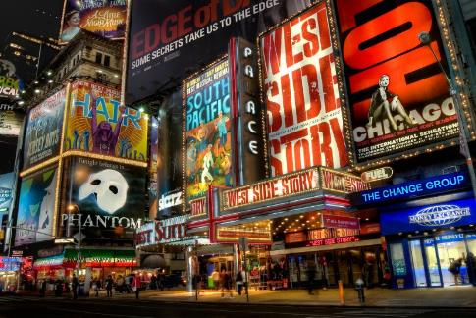
Leonard Bernstein
Leonard Bernstein grew up in Boston, USA. His family were Jewish and his parents came from Ukraine. Leonard’s family ran a hairdressing and beauty products business. His father wanted Leonard to continue the family business but this wasn’t Bernstein’s dream. Having learnt to play the piano at a very young age, Leonard’s passion was music. After finishing high school, he studied music at Harvard, one of the top universities in the USA.
After graduating, Leonard worked with several orchestras across cities in the USA. In 1943, at the last moment, he became assistant conductor of the New York Philharmonic Orchestra to conduct a concert in Carnegie Hall, one of the most famous concert venues in America. This concert was
broadcast throughout America over the radio and was the start of his popularity. Leonard later became music director of the New York Philharmonic.
Bernstein was the first to use television to
bring classical music to a huge audience
through televised concerts.
Photo courtesy of Randy Lemolne(@flickr.com) - granted under creative commons licence - attribution

Slide 11
Leonard Bernstein
Some of Leonard Bernstein’s most famous works include:
‘Candide’ – an operetta based on a story by Voltaire. It has won several Tony Awards (the musical version of an Oscar);
‘On the Town’ – a musical and a film about three sailors in New York. Two of the most famous actors of the time, Gene Kelly and Frank Sinatra starred in the film;
‘Chichester Psalms’ – a religious piece of music written in Hebrew;
‘West Side Story’ – a musical loosely based on ‘Romeo and Juliet’. It was turned into a popular film which won 10 Oscars, including Best Picture.

Slide 12
John Williams
Born: 8th February 1932

Slide 13
John Williams
John Williams is a famous American composer and conductor. John grew up in a musical family and his father was a jazz pianist.
John is best known for composing musical ‘scores’ or sound tracks to films. He composed music for some of the most popular films ever made, including E.T., the Star Wars films, three Harry Potter movies and the Indiana Jones films.
John Williams has worked with Steven Spielberg on more than 20 films.
John has won five Oscars and 21 Grammys. President Barack Obama presented Williams with the National Medal of Arts in 2010.

Slide 14
More Pieces Composed By John Williams
Listen to one of William’s most famous compositions, ‘Hedwig’s Theme’ from Harry Potter. Which instruments are being played?
Listen to a clip of the theme from Star Wars

Slide 15
Unsuk Chin
Born: 14th July 1961

Slide 16
Unsuk Chin
Unsuk was born in Seoul, South Korea, although she now lives in Germany. She was interested in music from a very young age and started to teach herself the piano.
Unsuk has composed classical music which has been performed by the best orchestras in the world, including the Los Angeles Philharmonic Orchestra, the Chicago Symphony Orchestra and the New York Philharmonic Orchestra. She has also written operas, including ‘Alice in Wonderland.’ As well as using traditional orchestral instruments, Unsuk has composed using technology such as electrical and digital instruments (for example electric guitars and keyboards).

Slide 17
Unsuk Chin
Unsuk has experimented with unusual patterns in her compositions. In ‘Miroirs des temps’, she uses musical palindromes, which is when a section of music is the same forward as it as backwards.
Try It!
Words can be palindromes too. Can you think of any words that are spelt the same forwards and backwards?
Unsuk has composed several pieces of music for poems, thinking about the rhythm of poetry and how that translates into music.
Try It!
Can you compose a tune for a poem you know?

Slide 18
Anna Clyne
Born: 9th March 1980

Slide 19
Anna Clyne
Anna was born in London. She started learning the piano when she was 7 years old and started cello lessons a few years later. Anna composed her first piece of music when she was 7 years old. She studied music at the University of Edinburgh and then in New York where she still lives.
Anna has composed many classical pieces of music, including ‘Prince of Clouds’ (a concerto for two violins and other string instruments), ‘The Seamstress’ (for a string orchestra) and ‘Night Ferry’ (a 20 minute piece of music for a full orchestra).
One of Anna’s most well-known pieces of music is ‘Masquerade’, written for a full orchestra. It was inspired by promenade concerts in London in the 18th century. People would walk through a park enjoying parts of concerts in different parts of the park.

Slide 20
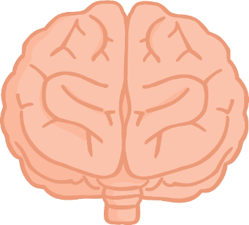
What Have You Learnt?
Write down a fact about each of the composers from this era:
George Gershwin
Duke Ellington
Leonard Bernstein
John Williams
Unsuk Chin
Anna Clyne

